Slide 1
Nimrod/K using Opal Services for Virtual Screening
David Abramson, Ilkay Altintas, Daniel Crawl, Wilfred Li, Jane Ren, Jianwu Wang, Colin Enticott(presenter)

Slide 2
Kepler
The cross-project Kepler collaboration
  UC Davis, UC Santa Barbara, and UC San Diego
Workflow engine
Tasks are represented by “actors” that can be placed on a canvas to construct a workflow.
Has an inbuilt Opal actor that can call upon Opal WebServices

Slide 3
Nimrod/K
Monash University
Adds dynamic parallelism to Kepler which allows concurrent execution of Kepler’s actors.

Slide 4
Autodock Opal service
National Biomedical Computation Resource
Has a WebService interface for remote submission
Supported by a 50 node cluster to allow concurrent processing of requests

Slide 5
Results
Using Nimrod/K we were able to concurrently submit 10 requests to the Autodock Opal service and wait for the results to return.
All requests were executed concurrently by the Autodock Opal service.

Slide 6
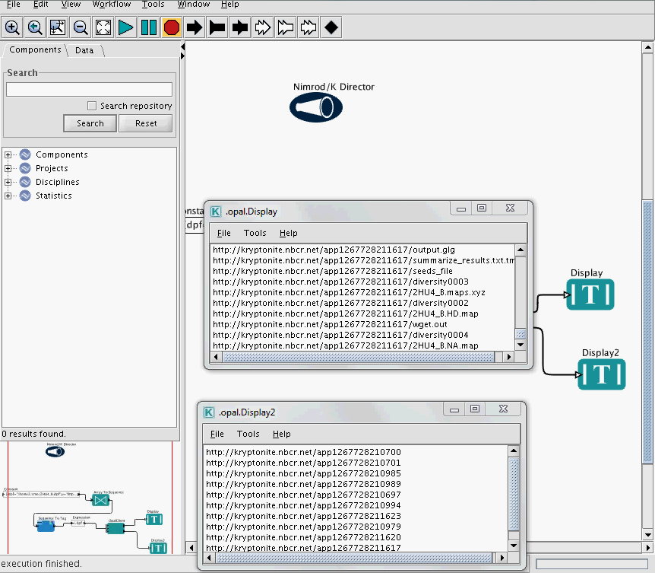
Screen grab

